Slide 1
Welcome!
Hari Polnati

Slide 2
Object oriented programming (oops) - A paradigm to design a program using Classes and Objects

Slide 3
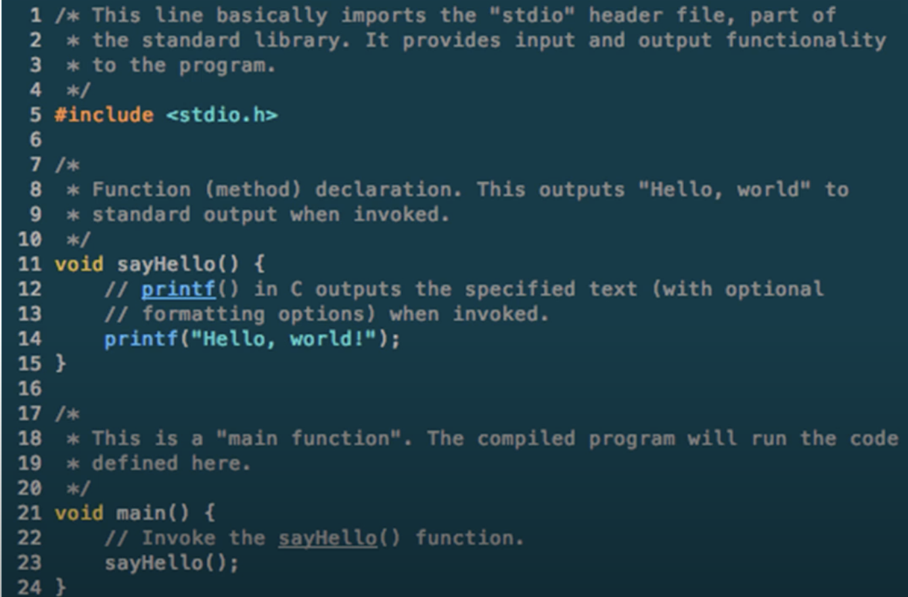
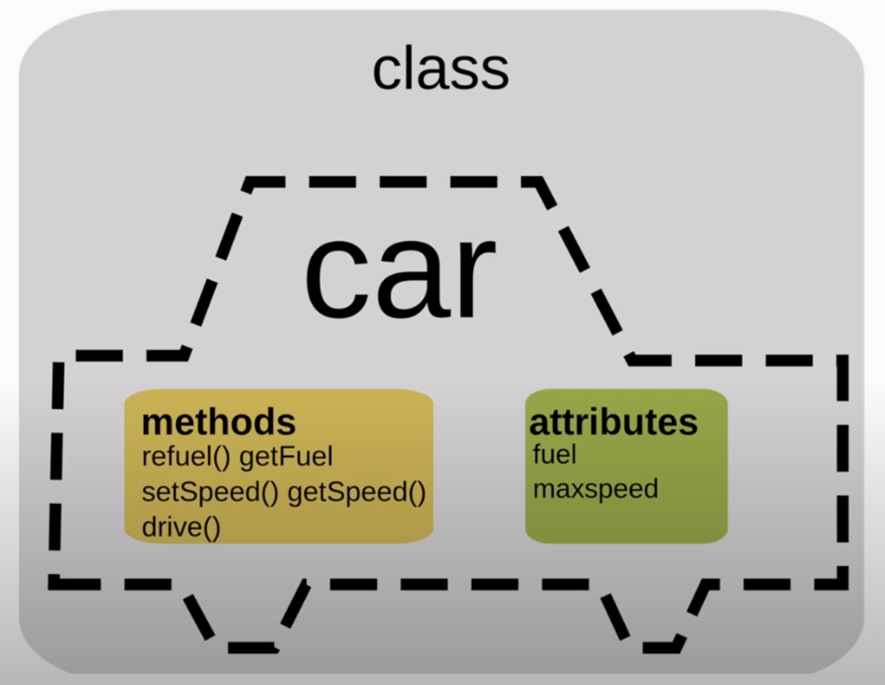
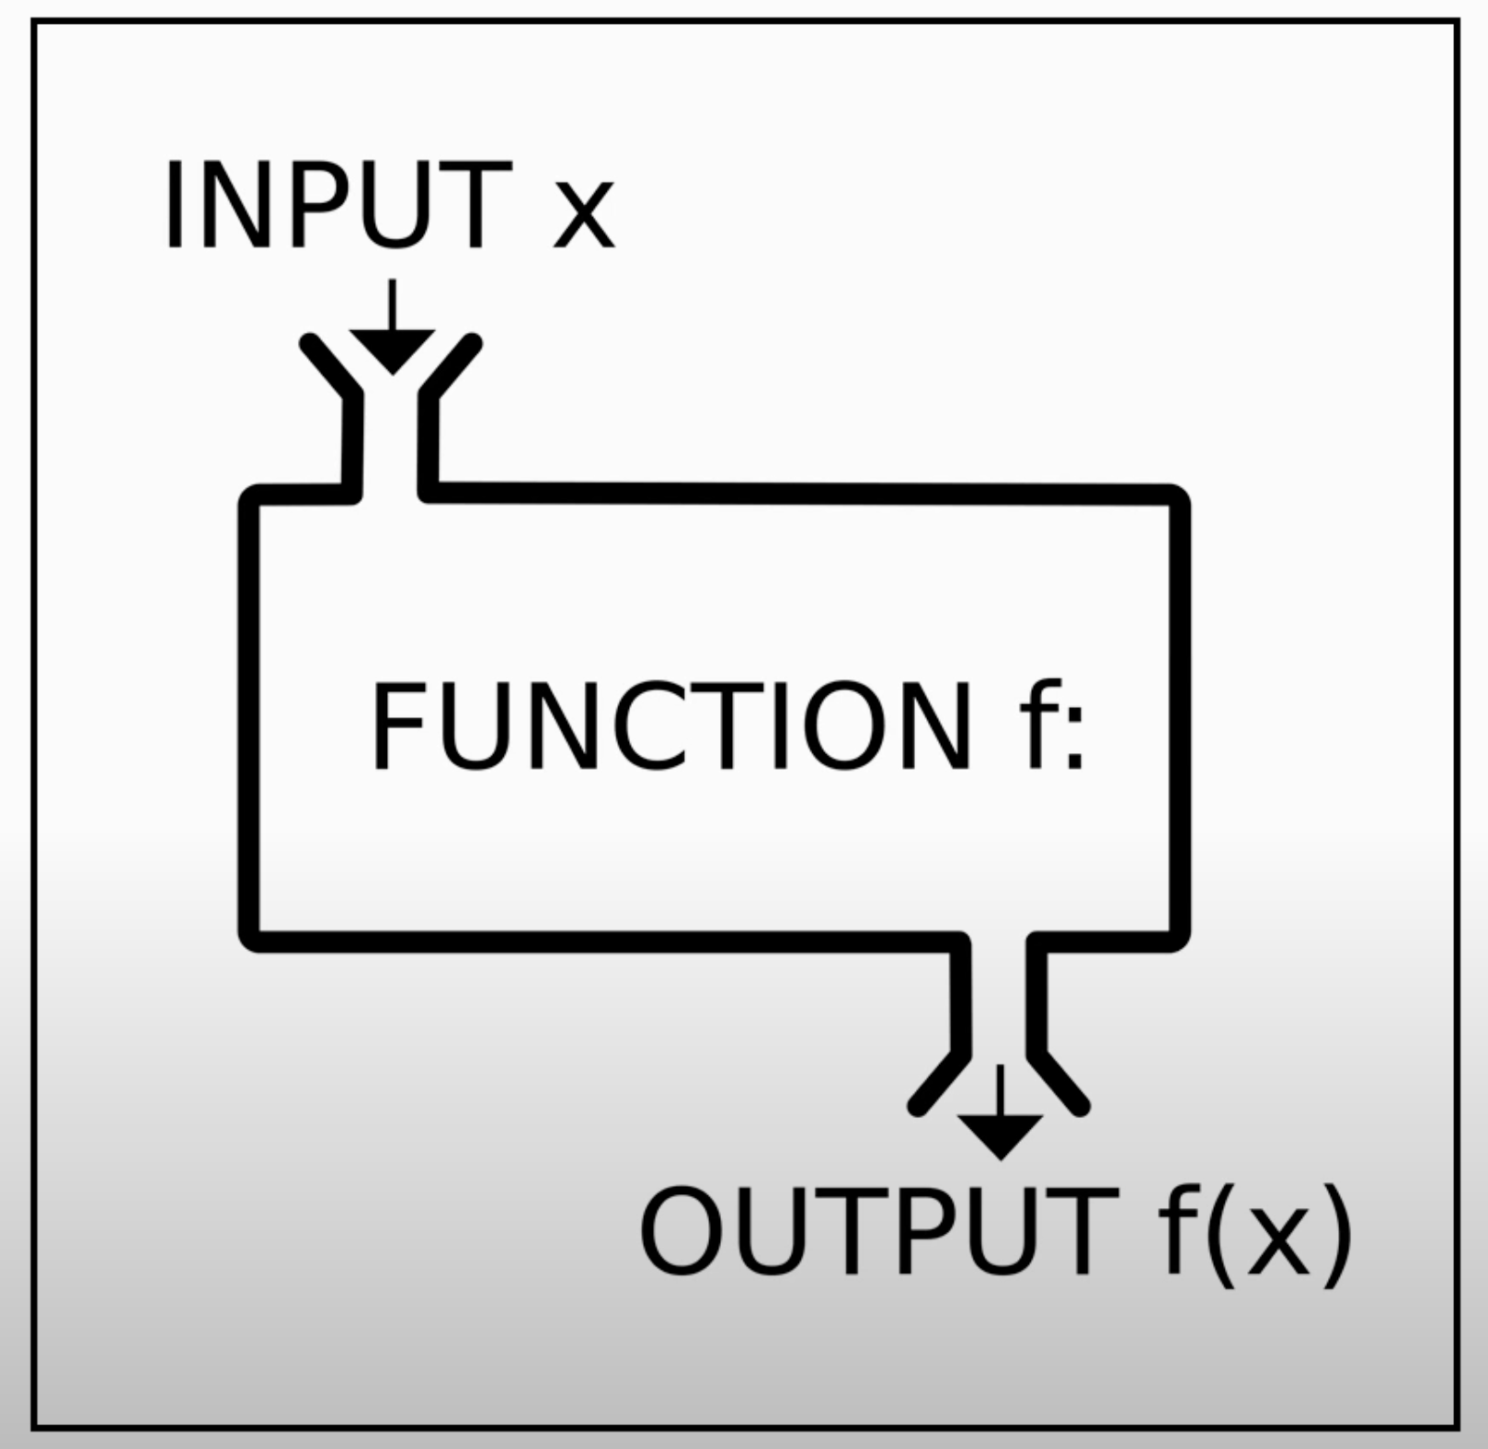
Programming Paradigms - How code is organized/structured
Procedure Oriented
Object-Oriented
Functional Oriented
Procedure
Object-Oriented
Functional

Slide 4
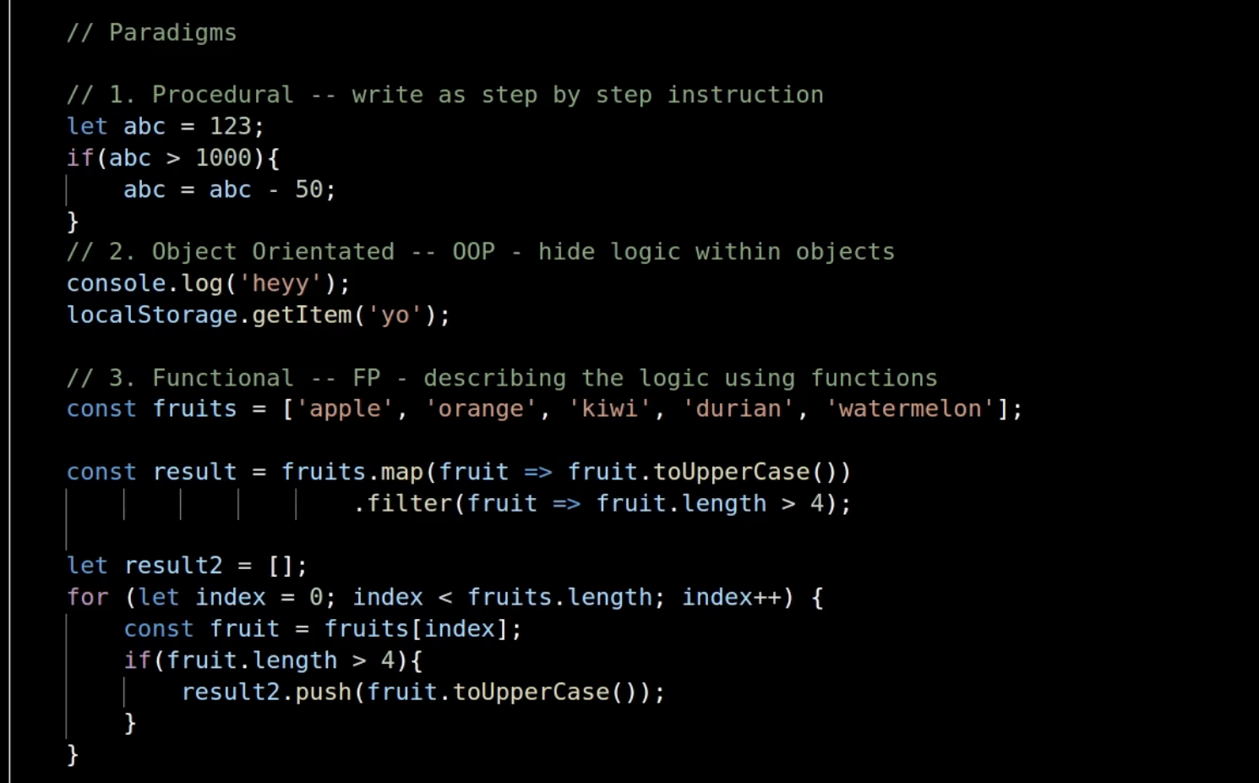
Another example!

Slide 6
Procedural/Structured Programming
Object Oriented
Programming
Thinking in terms of procedures/methods/functions
Thinking in terms of objects and classes
Global data
fly(){
trvaleToAirport();
findEntryGate();
findCheckInCounter();
checkIn();
securityCheck();
waitForBoardingCall();
boardTheFlight();
takeOff();
landing();
}
Aeroplane
airline,make,type,position //data (state)
takeOff(), land(); //methods (behaviour)
AirHostess
name,address// data
wish(),server() //methods
Passenger
name,address //data
takeCab(), checkIn(),walk() // methods

Slide 7
Problems with Procedure oriented (Fortan, Cobol, C and etc…)
1.Data Doesn’t have any owner
2.Difficult to maintain data integrity
3.Functions are building blocks
4.Many functions modify give block of data
5.Difficult for debugging to find the bugs

Slide 8
Continue….
6.Unintilaized varibales
Ex: int a;
printf(“%d”,a);
7.Resource Deallocation problems
8. Memory leaks, open files, open data base connections, Open network connections
int *kp
Kp =(int *) mallaoc(1000);
Kp =(int *) mallaoc(1000);
9.Insufficient support for Abstraction
ADT = data + functions
Data: modeled as structures
Functions: global not related to structure

Slide 9
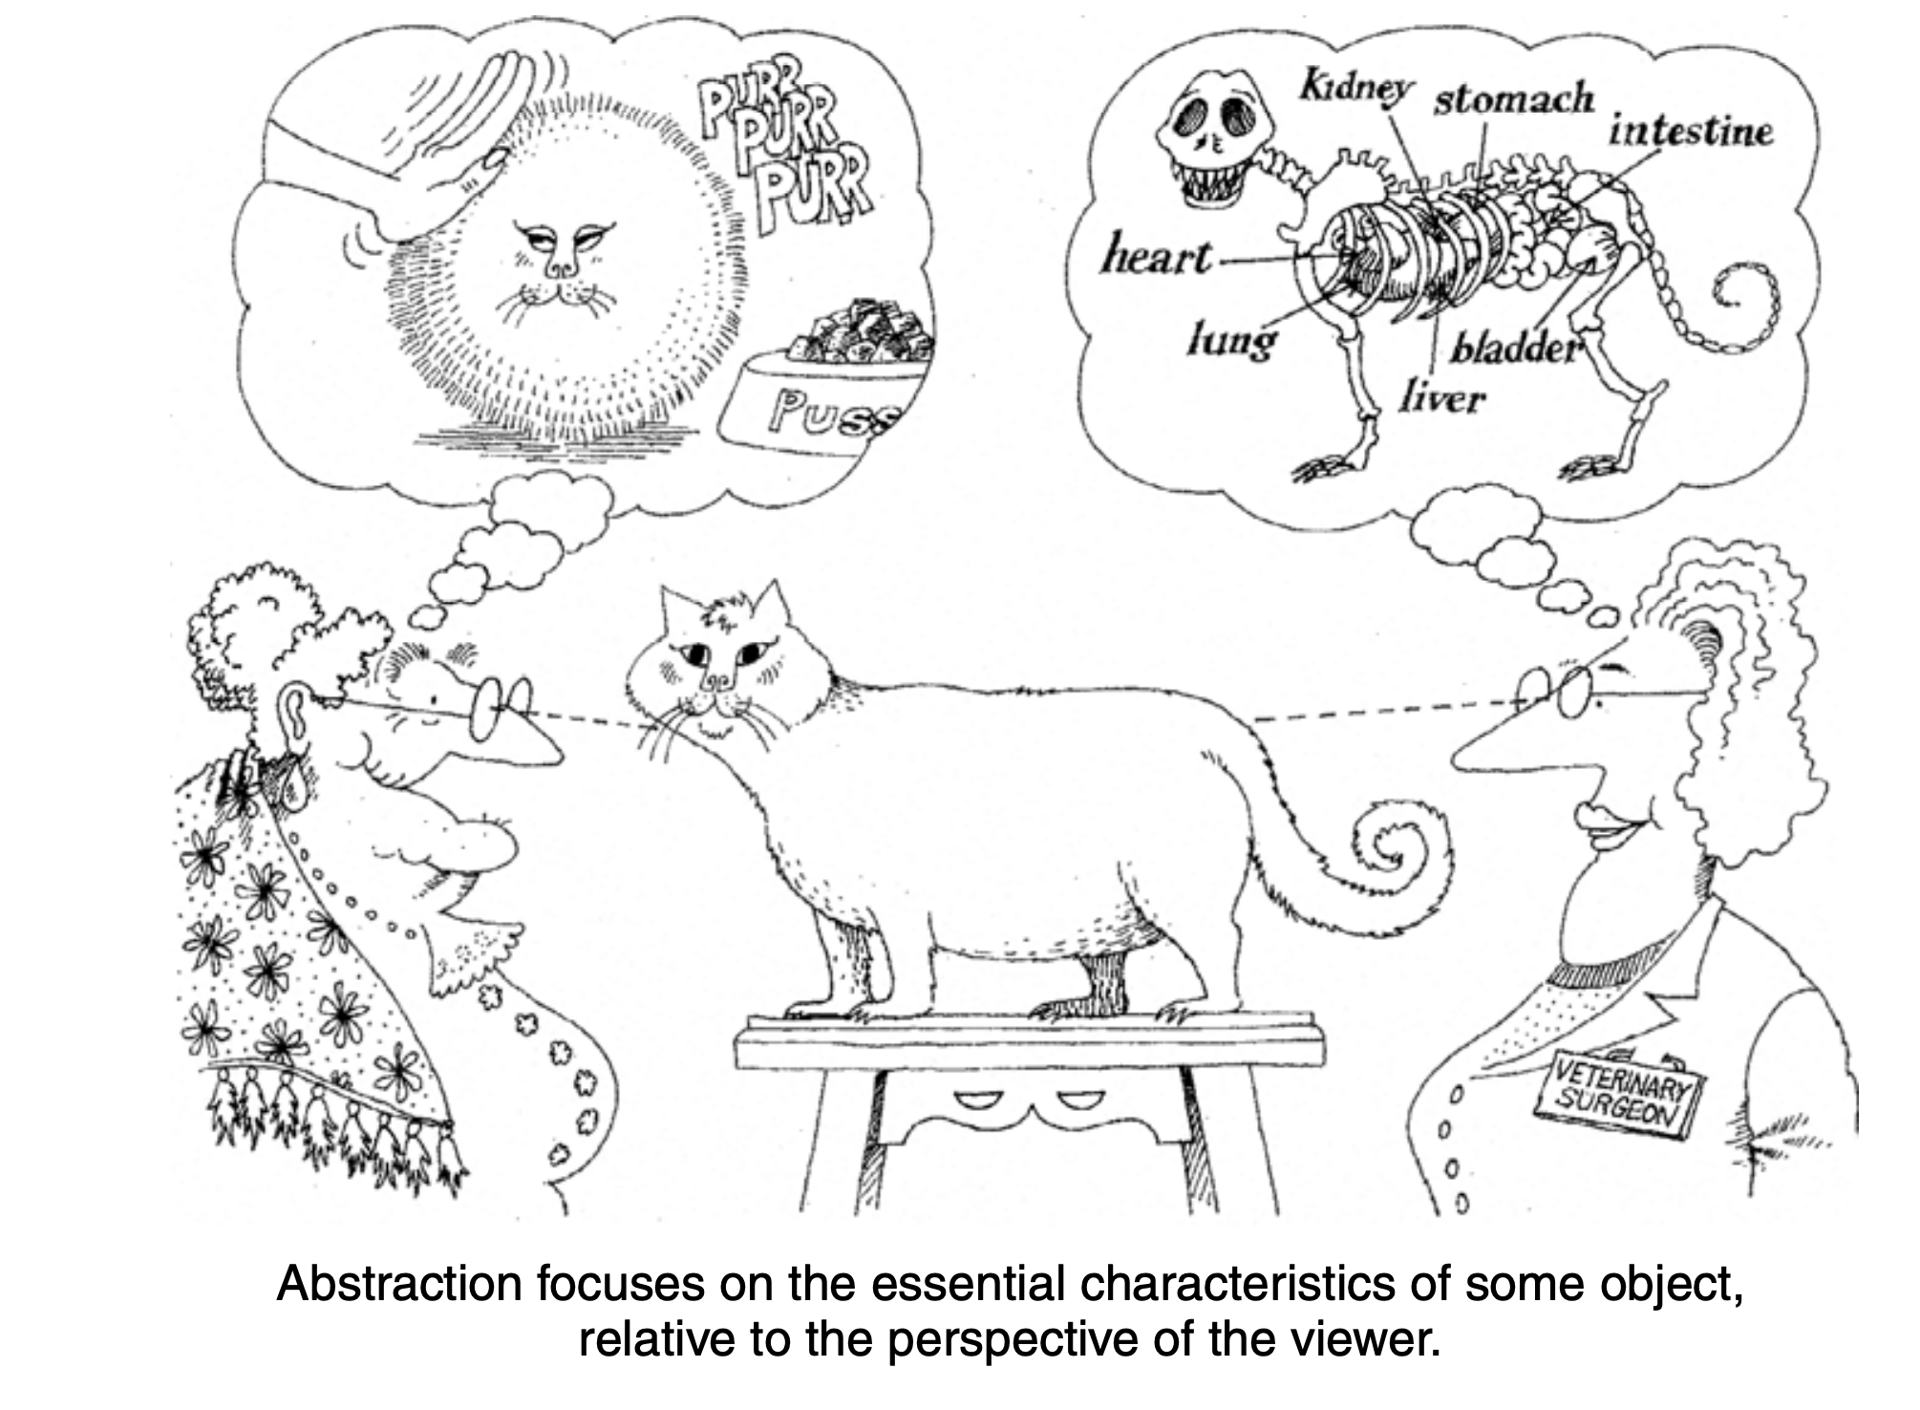
What exactly meant for Abstraction
Reference: Object-Oriented Analysis and Design with Applications by Grady Booch

Slide 10
Problems with pop
struct stack {
int top;
char *store;
}
struct queue {
int front, rear;
char *store;
}
struct horse {
weight, color
age;
}
struct eagle {
age,color
wingspawn;
}
push();
pop();
gallop();
canter();
fly();
hunt();
insert();
delete();
All functions are global;
All functions are global;

Slide 11
Better Abstraction with oops
class stack {
int top;
char *store;
class queue {
int front, rear;
char *store;
insert(),
delete();
}
class horse {
weight, color
age;
gallop();
canter();
}
class eagle {
age,color
wingspawn;
fly();
hunt();
}
push();
pop();
}
Class = State + Behavior

Slide 12
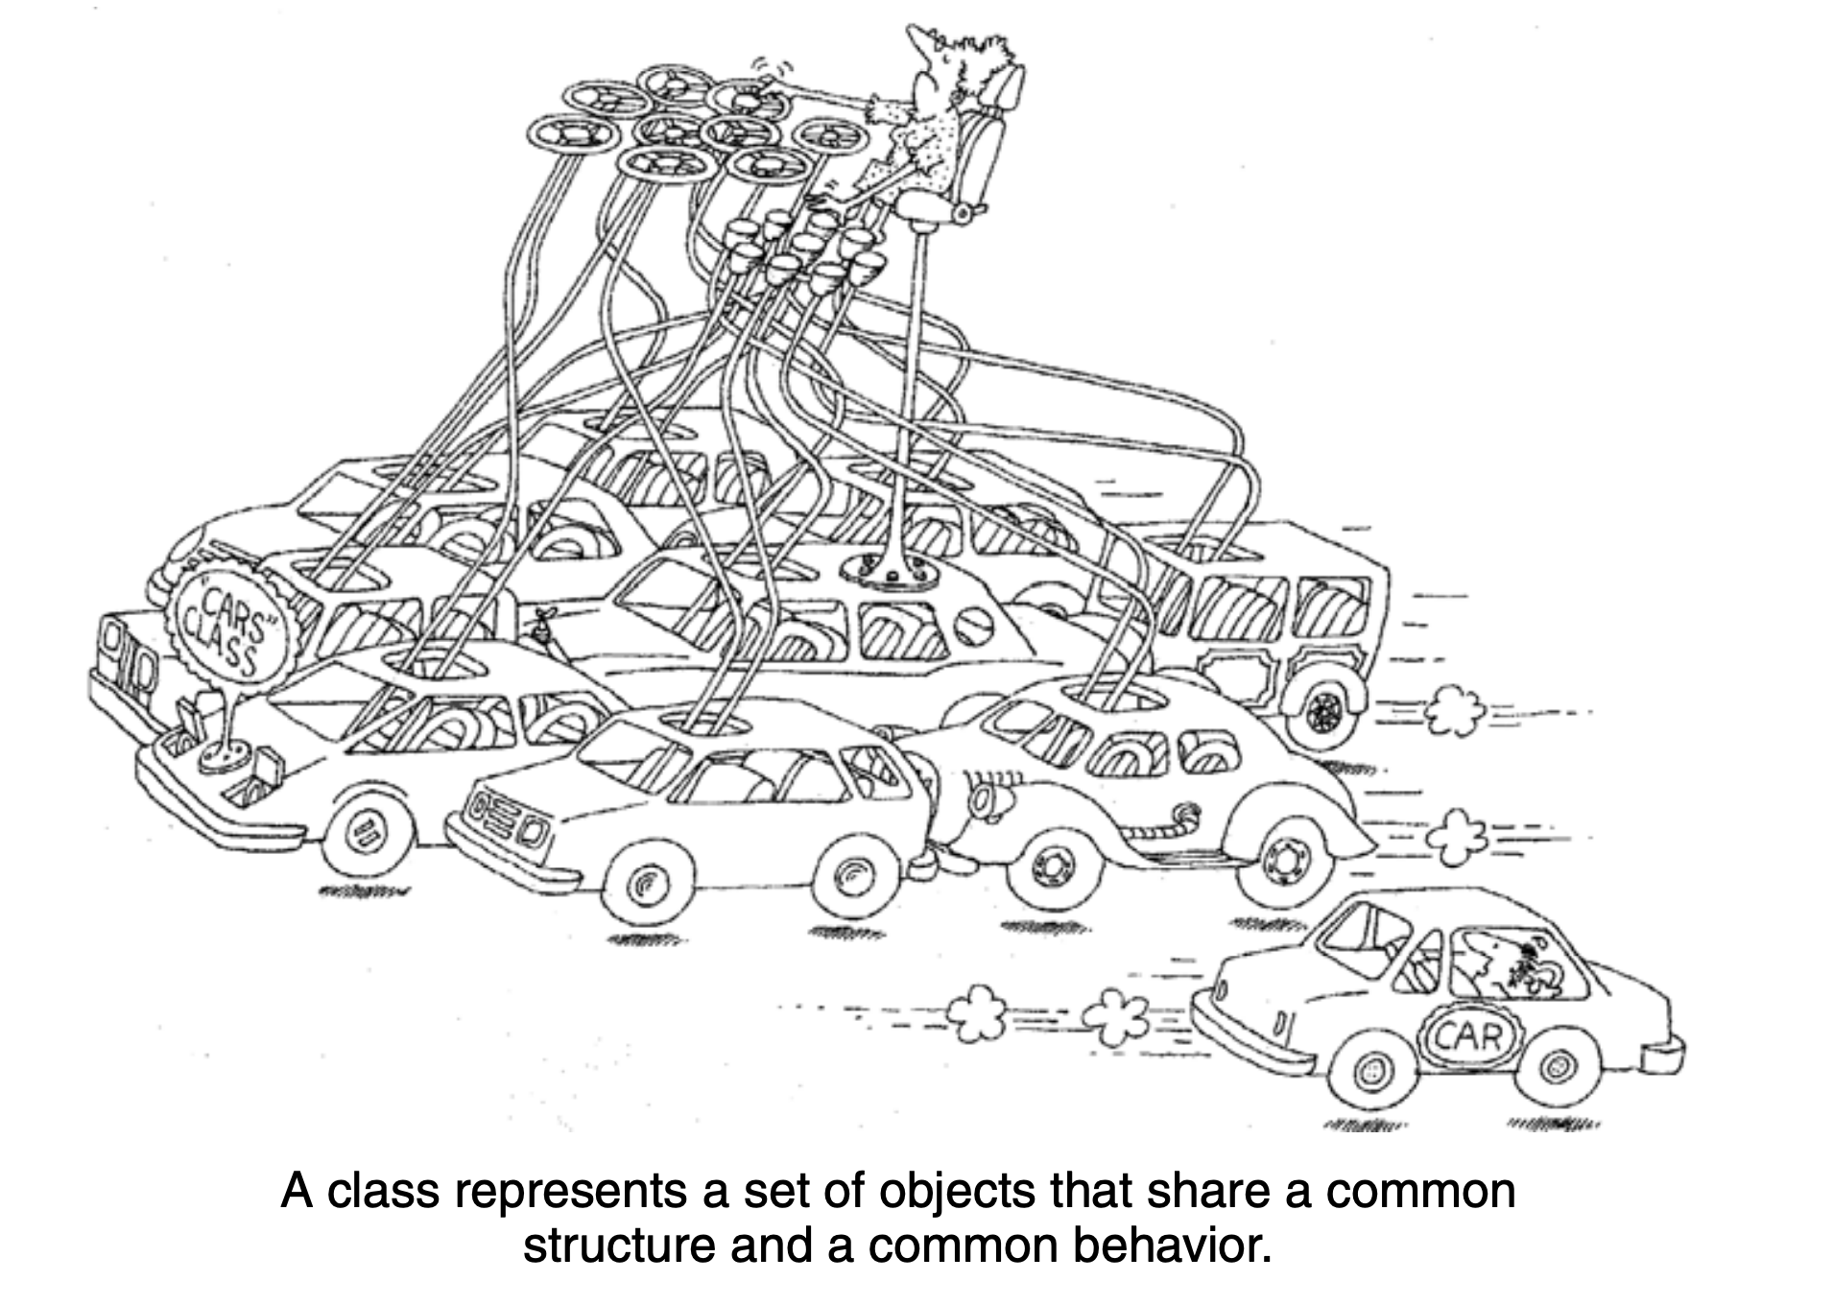
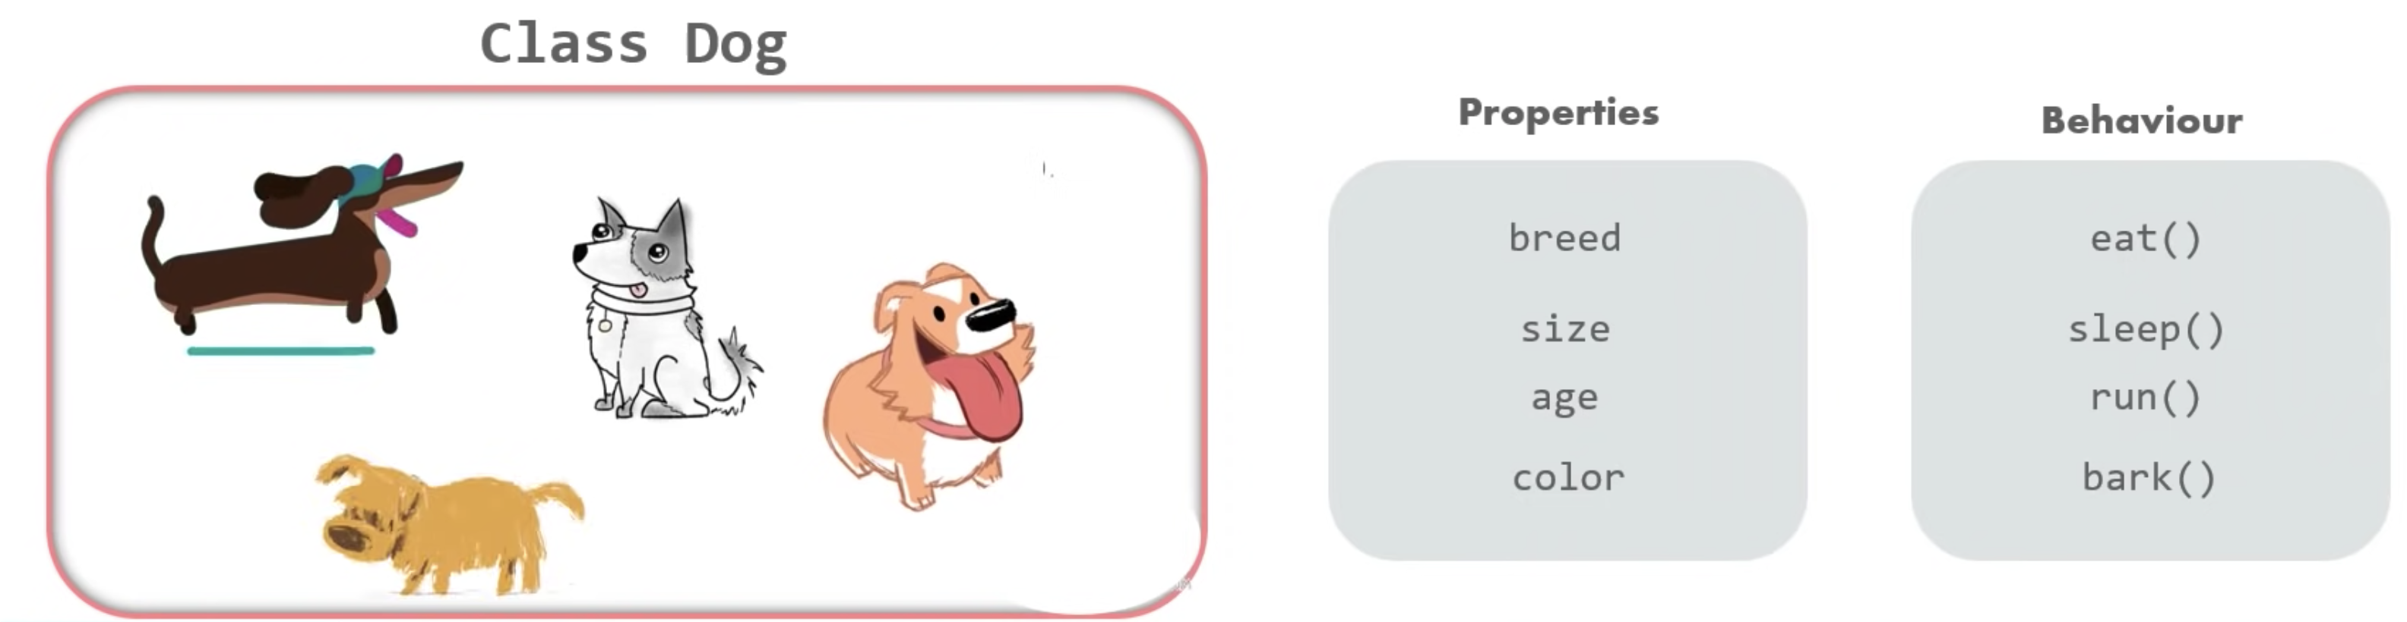
Class = State + Behavior
State
data members (c++)
fields (java)
properties (visual basic)
Behavior:
methods – Java
member functions – C++

Slide 13
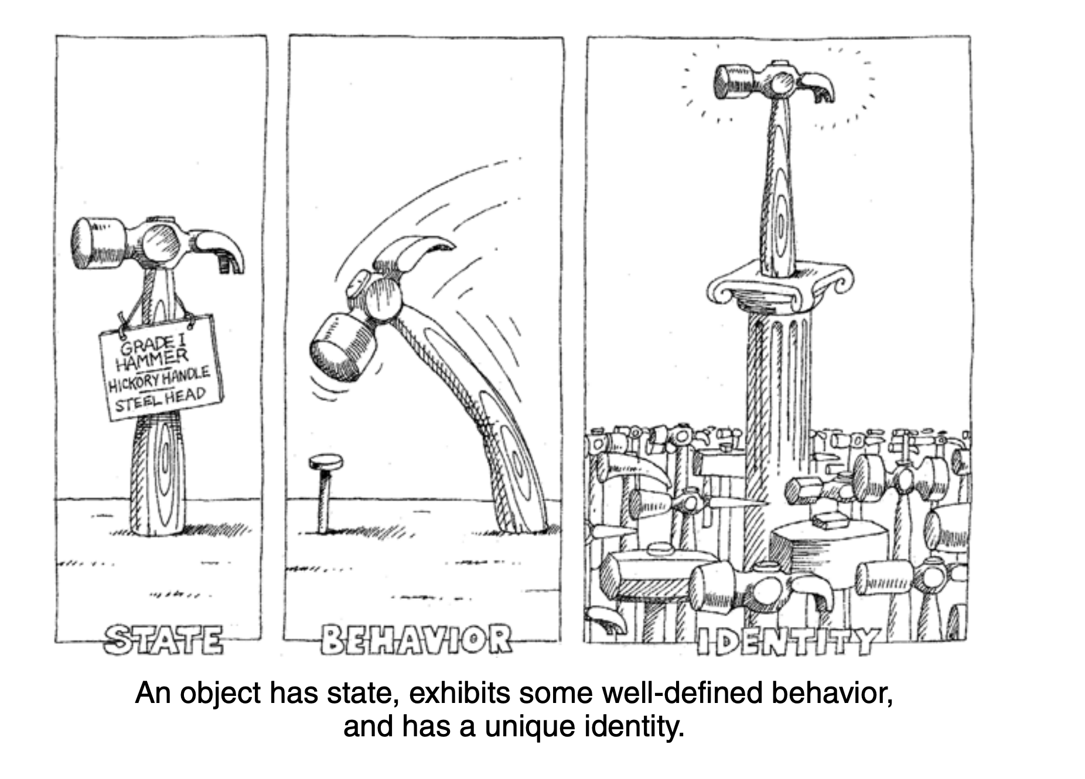
Object

Slide 14
Problems with public garden ?
Owner
Public Garden

Slide 15
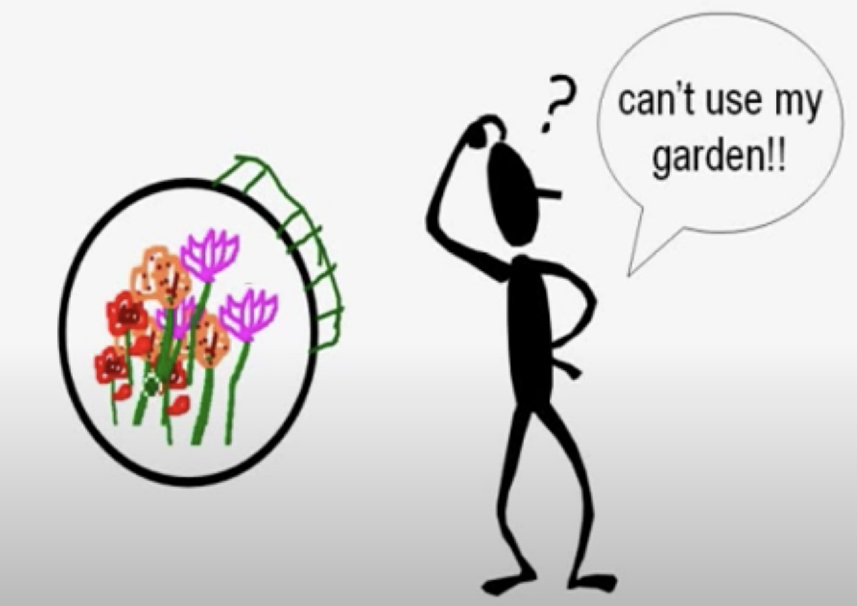
Soluction1: Building High Fence
Owner
Garden with fencing

Slide 16
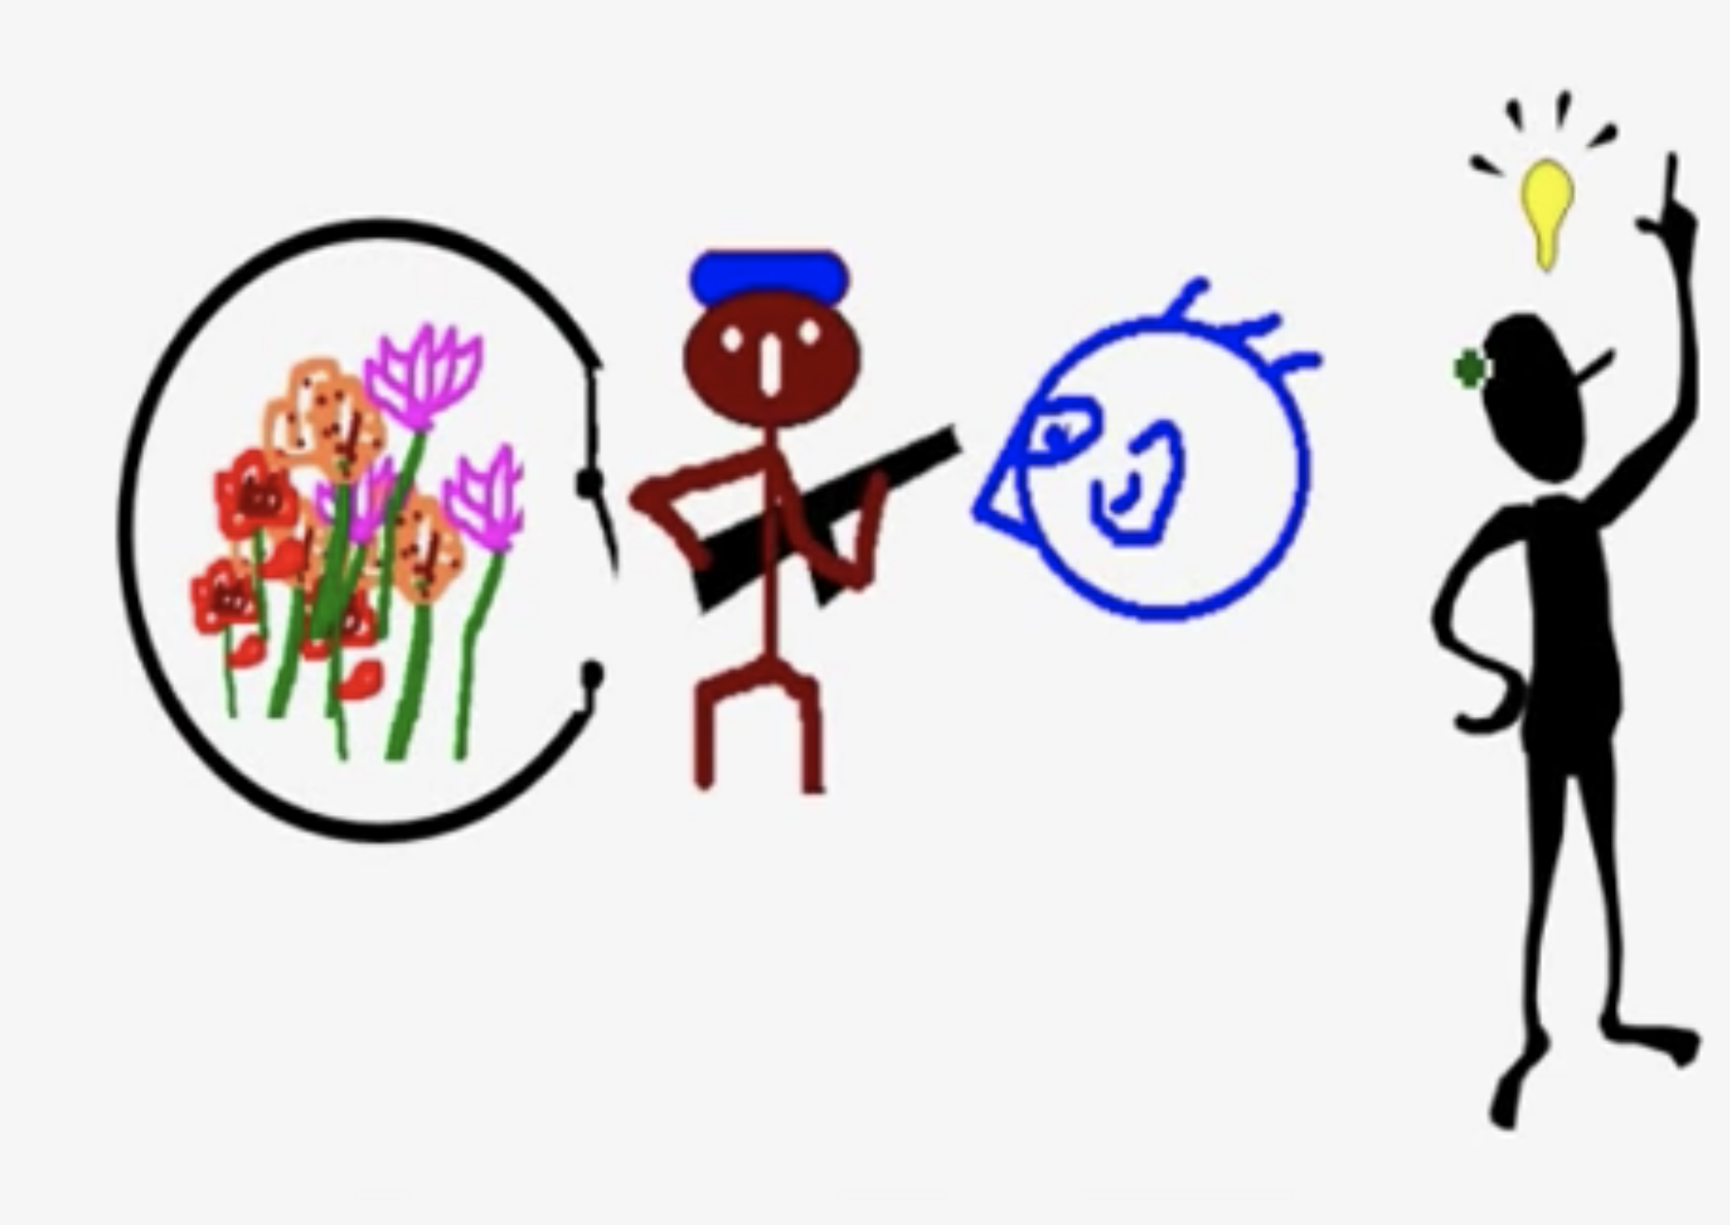
Soluction2: Private Garden with Guard
Outside Person
Guard
Garden
Owner

Slide 17
Write methods to safeguard of data

Slide 18
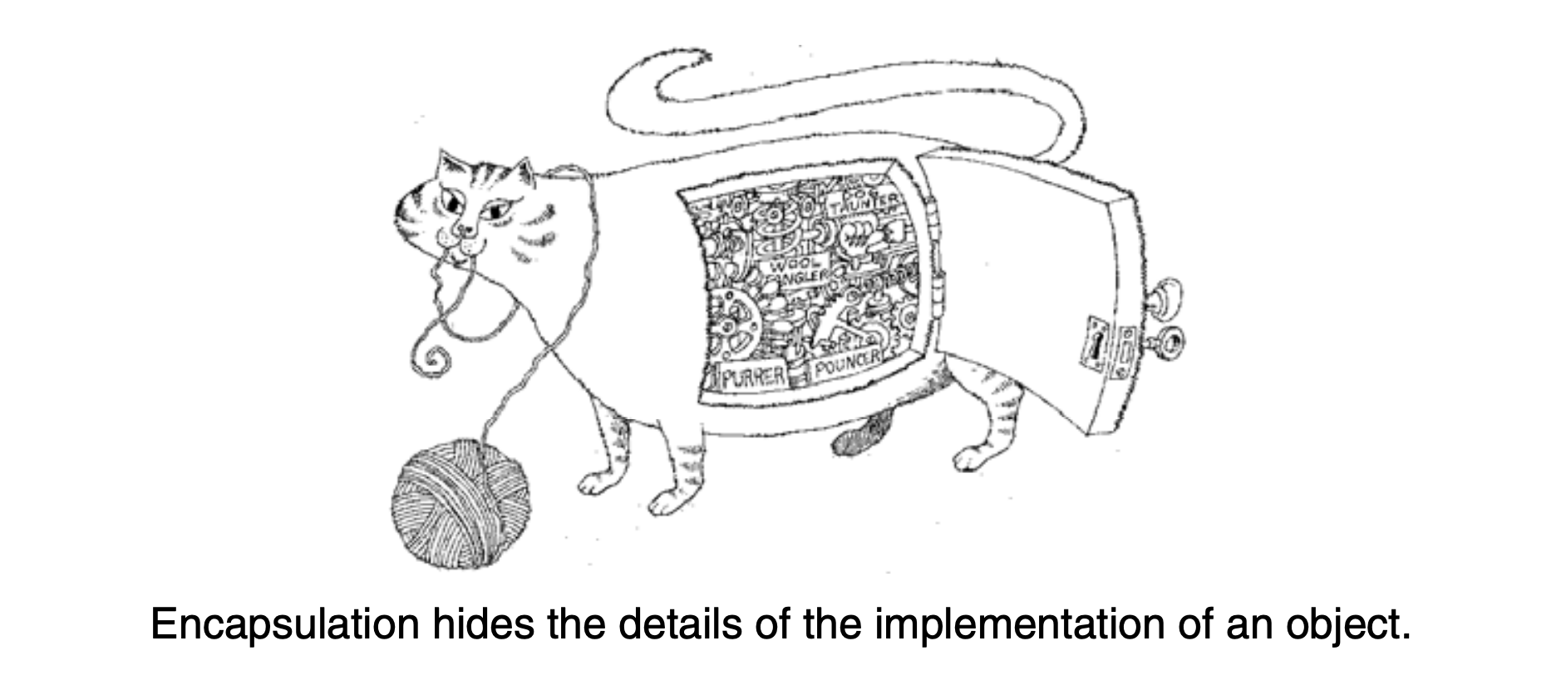
Encapsulation
Data must be hidden – Private
Read data through read methods
Write data through write methods
Can’t access directly
For every data 4 possibilities
read and write allowed
read only
write only
no access

Slide 19
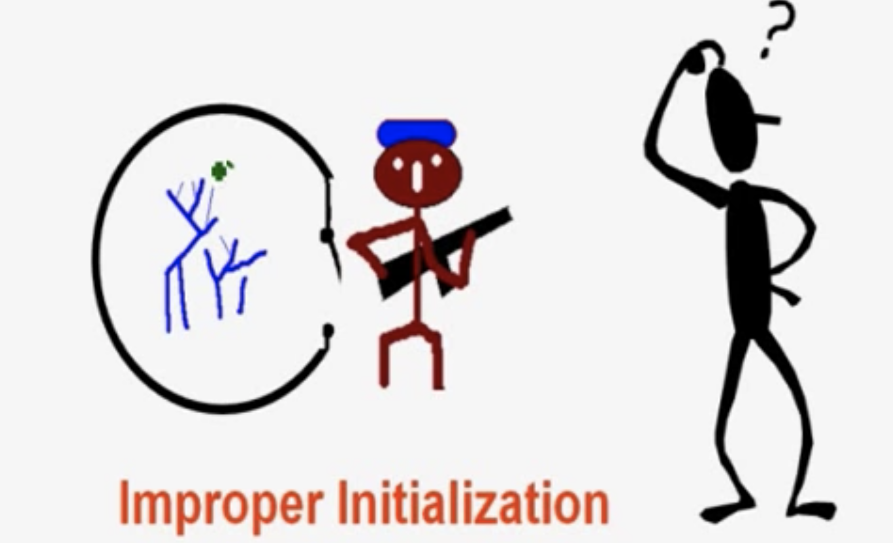
Initiaisation of objects
Garden has only weeds
Rersource Allocation:
Special concept called : constructors
Ensure correct intilization of data
Automatically called at the time of objet intilization(creation)
Soluction
Rersource Deallocation:
Special concept called : destructors
Ensure correct deallocation of all resouces befores object dies
Problem

Slide 20
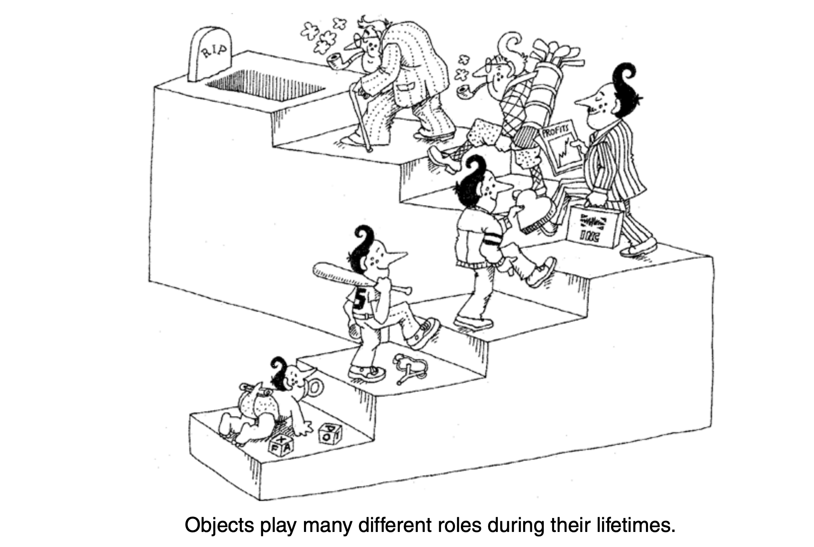
Object Lifecycle
Born healthly – using constructors
Live safely – using read and rwrite functions
Dies cleanly – using destructors

Slide 21
Anotomy of the Class

Slide 22
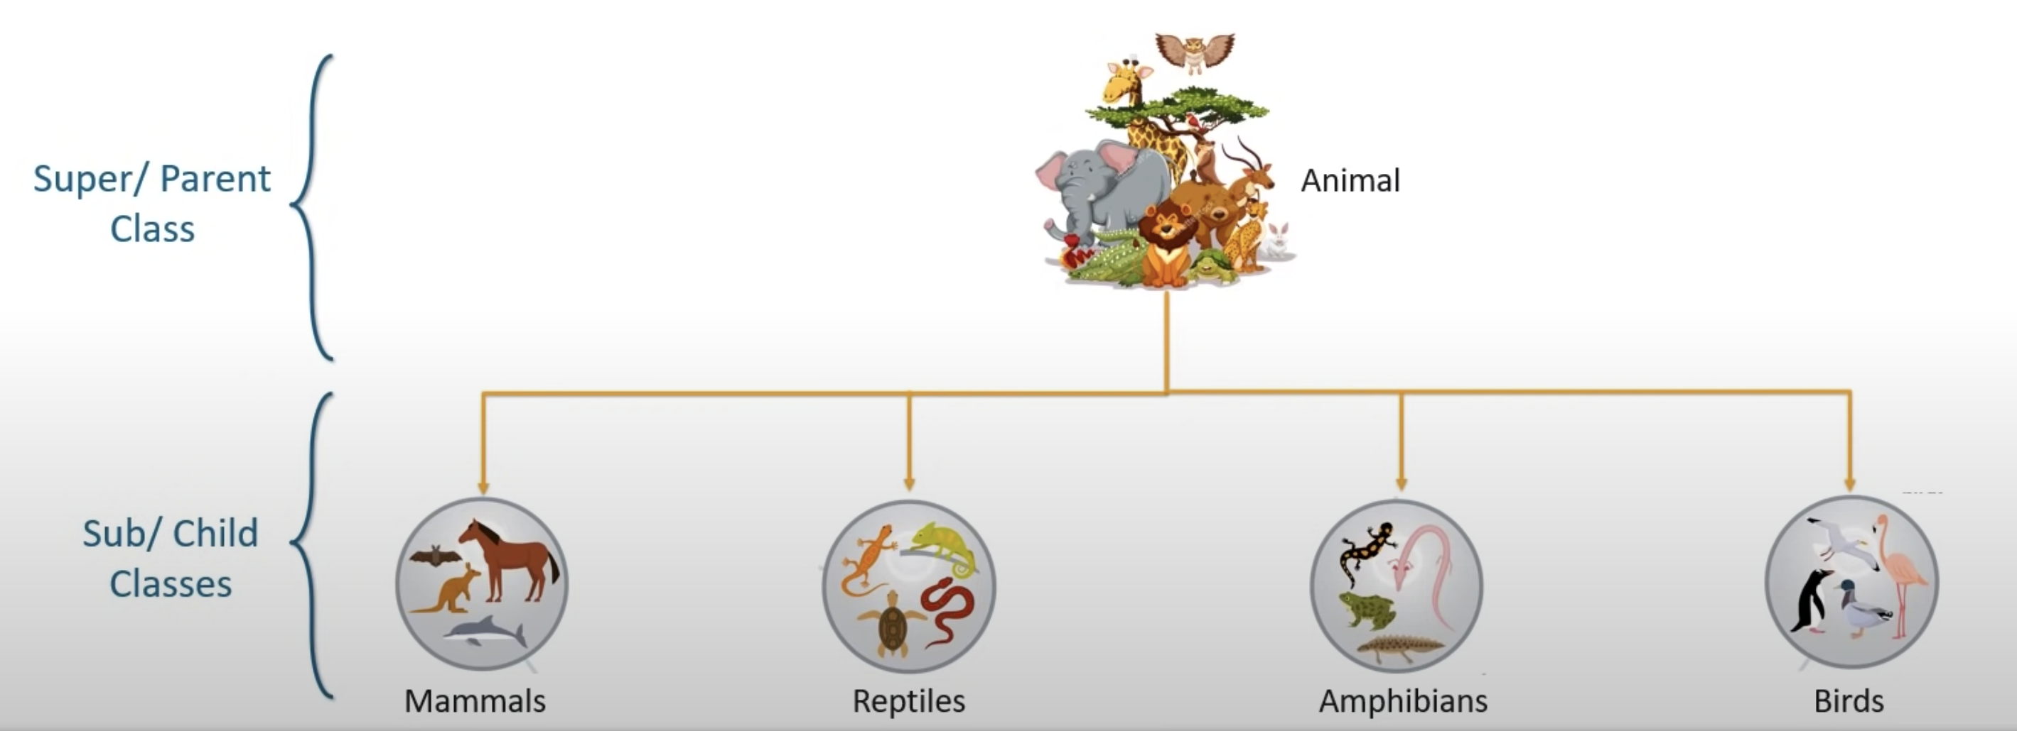
Inheritance
Inheritance is the capability of one class of things to derive capabilities or properties from another class.
IS-A relationship.
Code reusability and extensibility

Slide 23
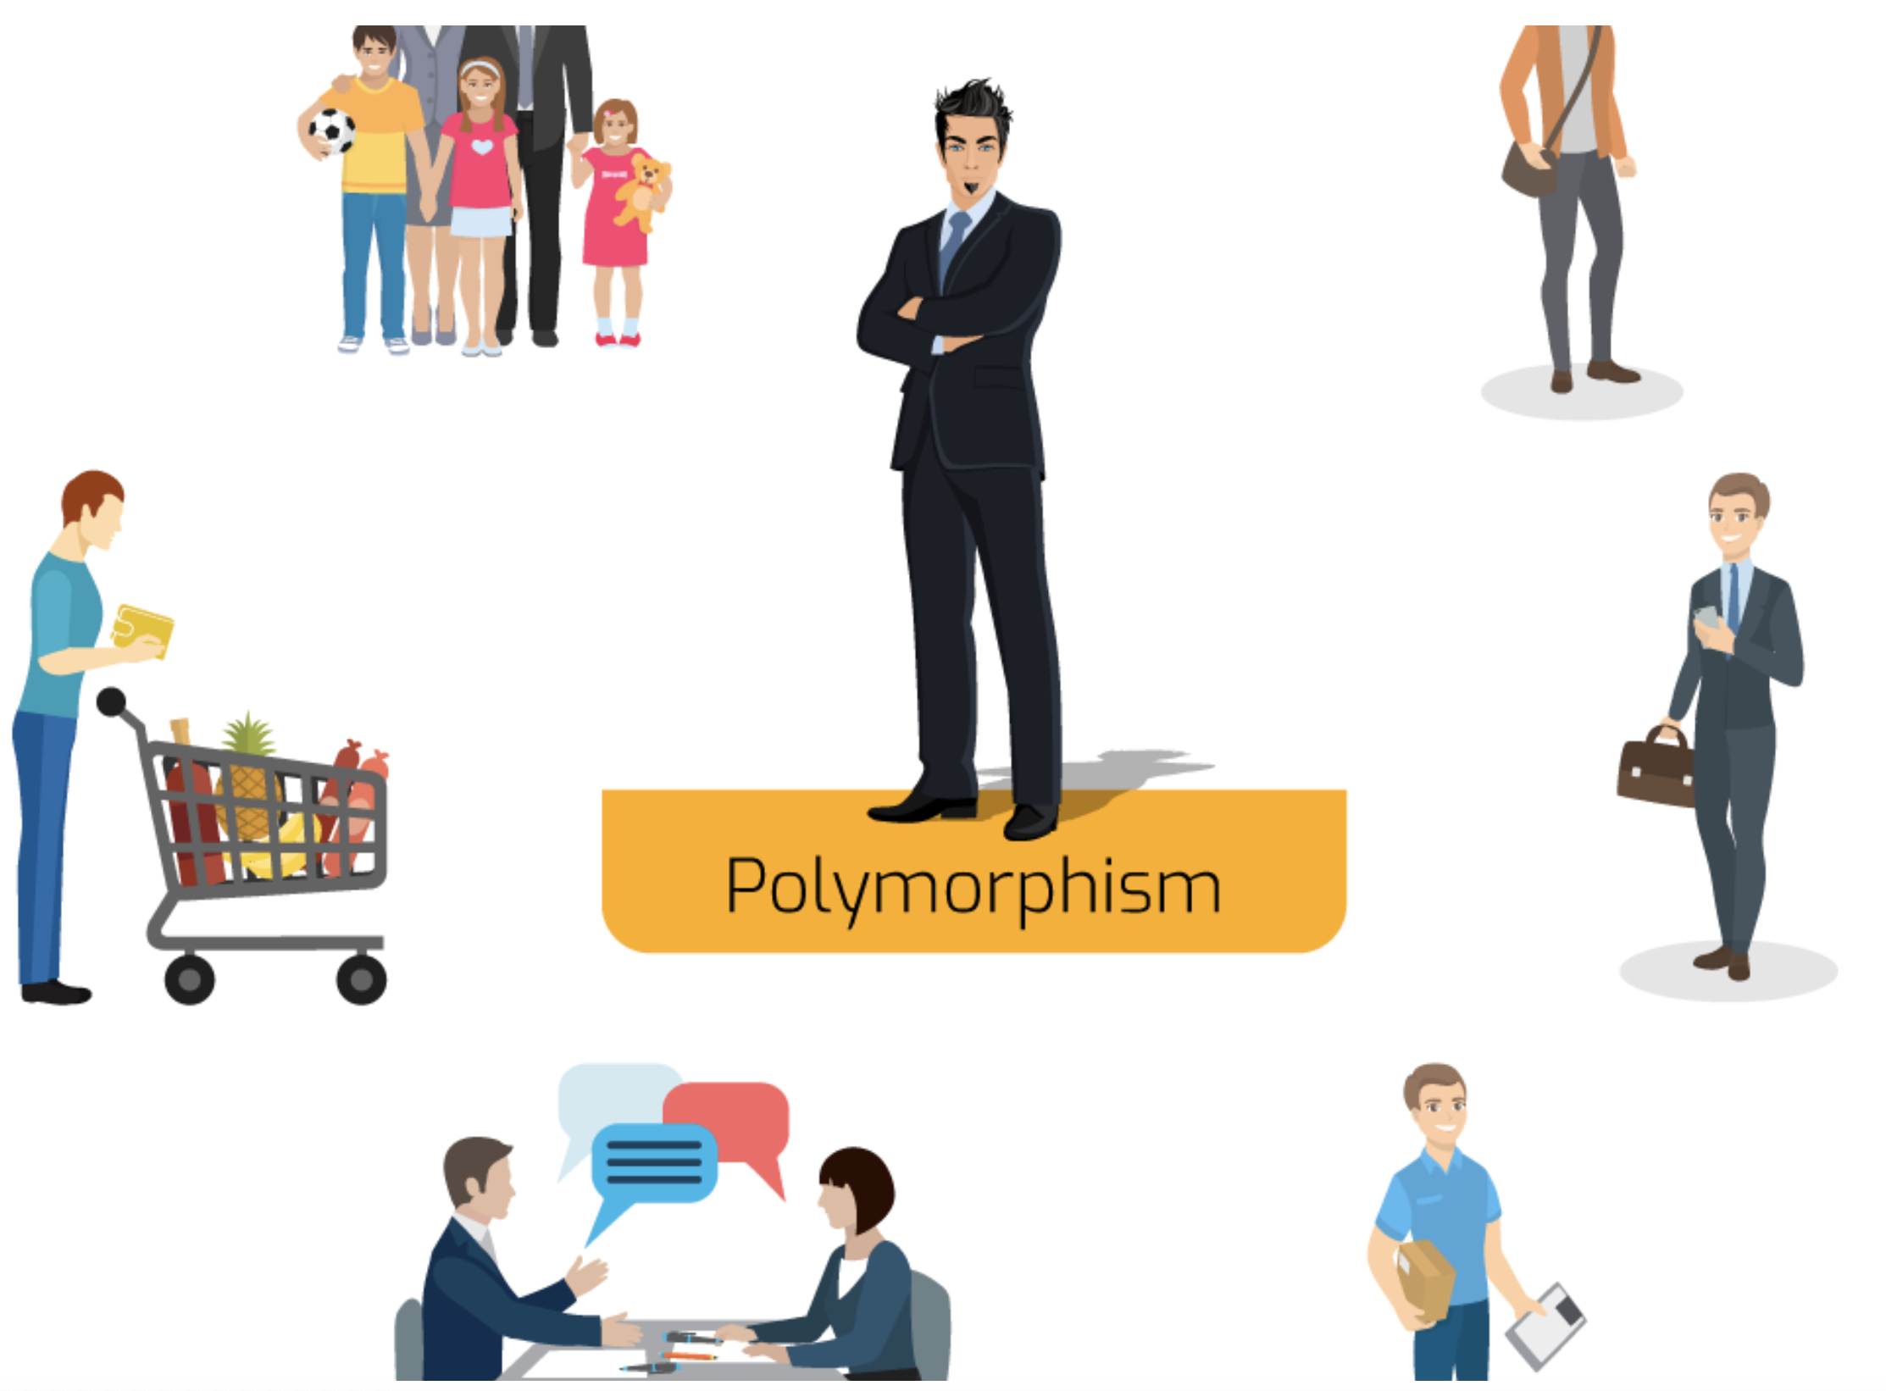
Polymorphism = Poly (many) + morphism (forms)
Example 1
Example 2

Slide 24
Types of Polymorphism
Compile time - Overloading is an example
Runtime – Overriding is an example

Slide 25
Modularity
Modularity is the property of a system that has been decomposed into a set of cohesive and loosely coupled modules.
classes
Packages
domains

Slide 26
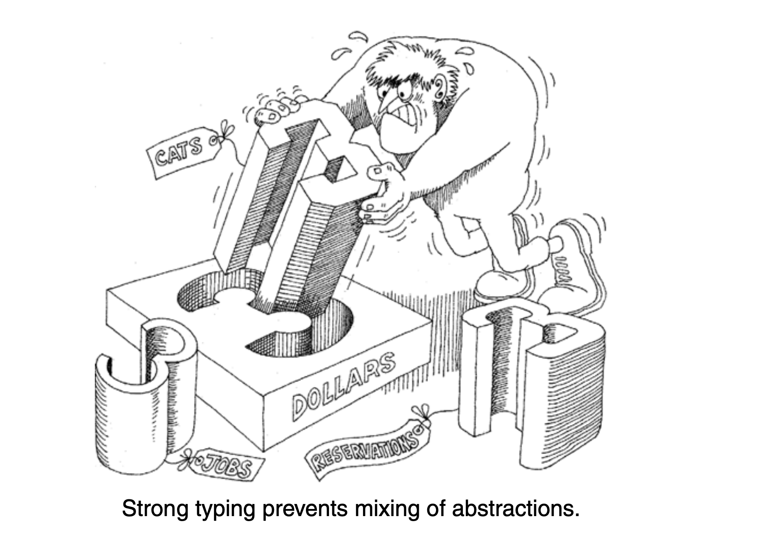
Strong typing
Strong typing prevents
mixing abstraction
X =Y if x and y are objects of the same class

Slide 27
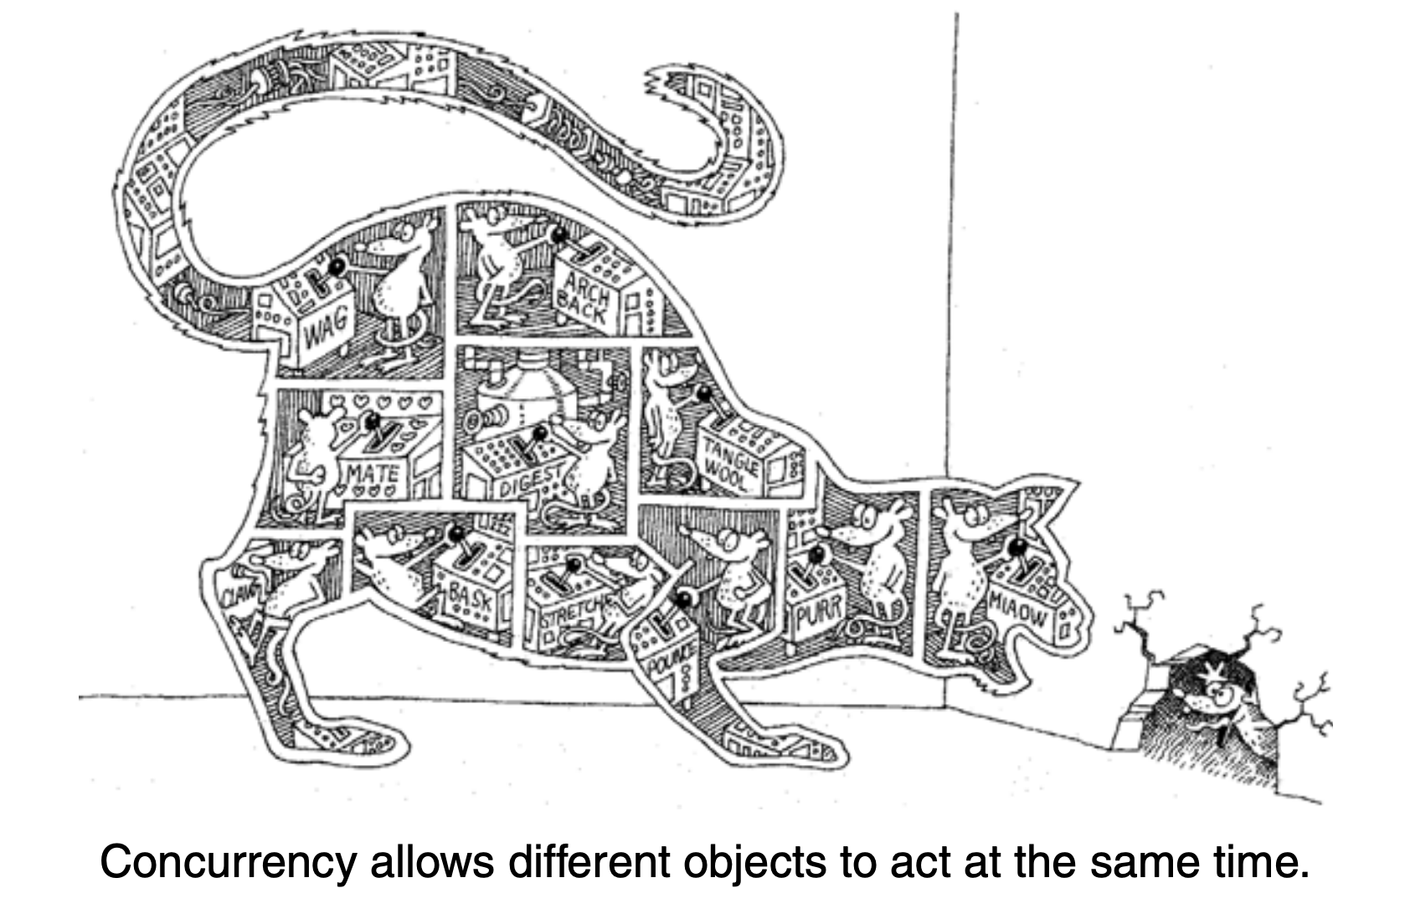
Concurrency
Concurrency allows different objects to act at the same time.
Java supports multi-threading is a form of concurrency

Slide 28
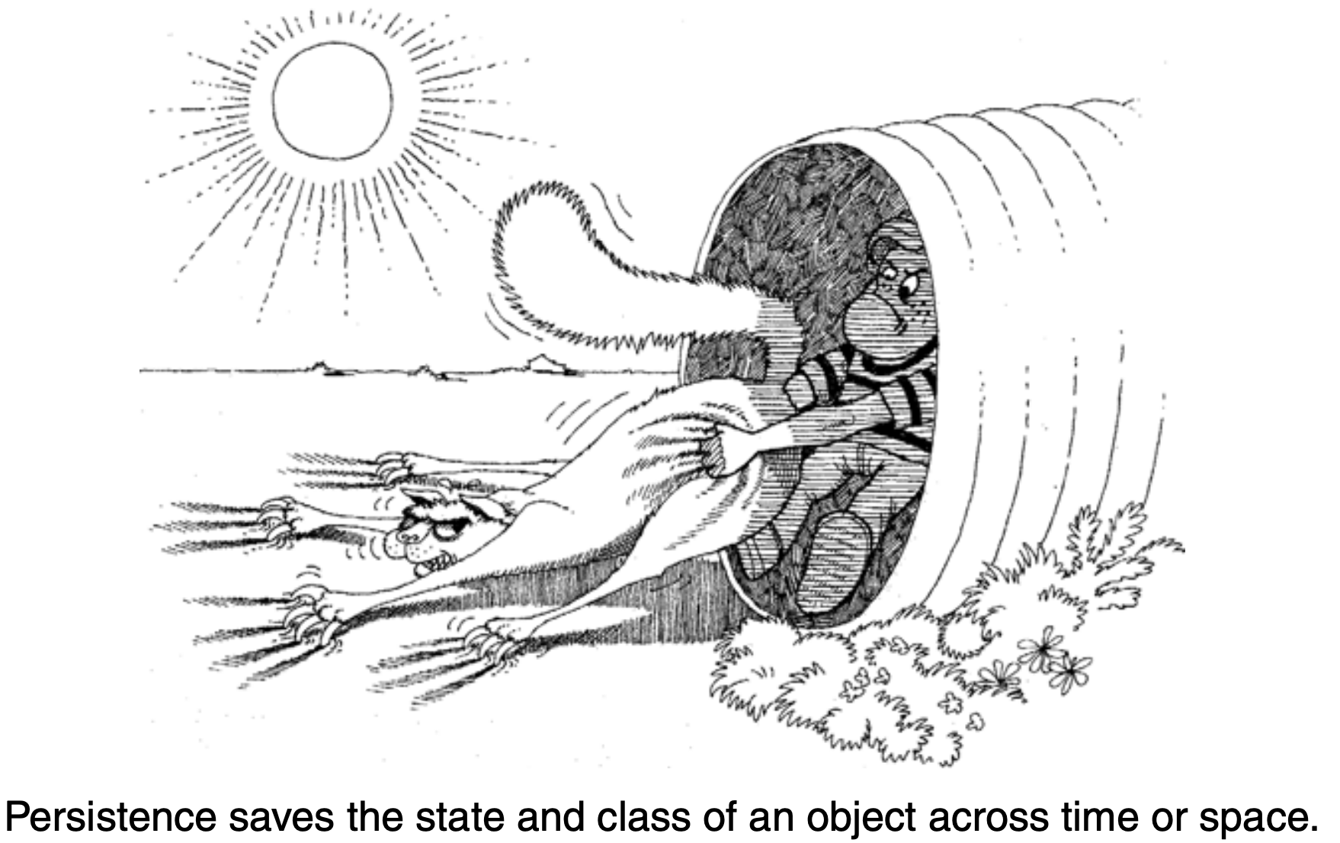
Persistance
Persistance saves the state of a class of an object across time and space. i.e., Storing on permanent storage media
Object serialization is supported by java
Can also used to mapping to RDBMS using some Object/Realational mapping schema.

Slide 29
